Slide 1




Slide 2
CHAPTER 1
THE ABC OF PROGRAMMING

Slide 3
B

Slide 4
HOW DO COMPUTERS FIT IN WITH THE WORLD AROUND THEM?

Slide 5
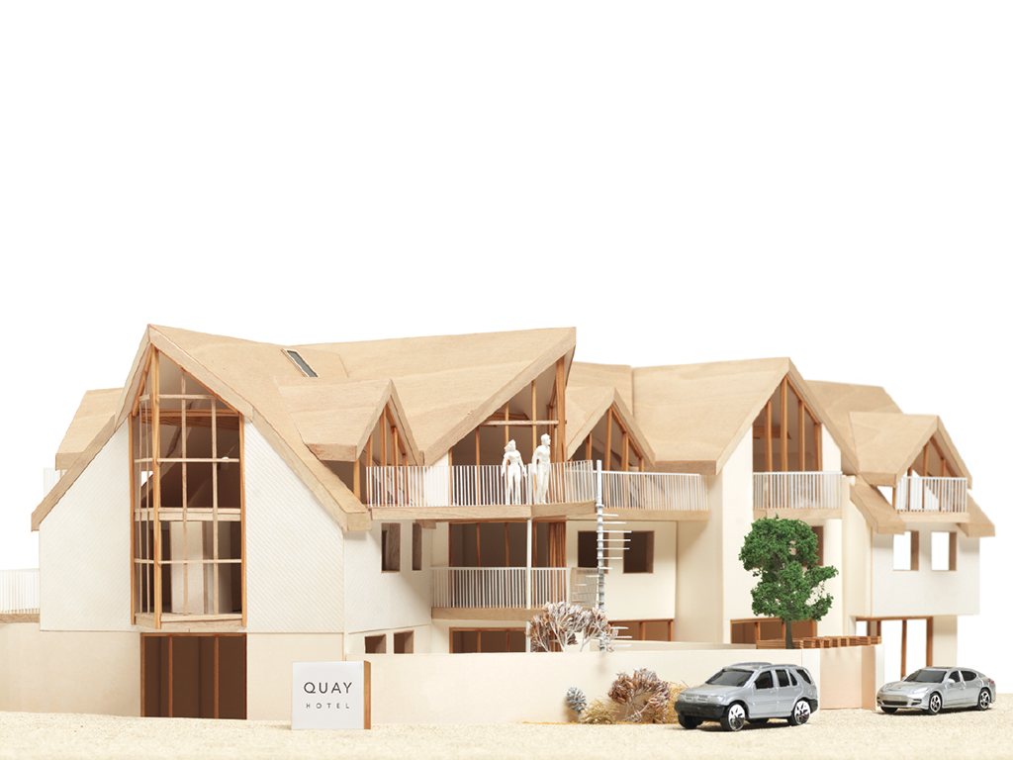
Here is a model of a hotel, along with some trees, people, and cars.

Slide 6
To a human, it is clear what kind of real-world object each one represents.
OBJECT TYPE: HOTEL
OBJECT TYPE: CAR
OBJECT TYPE: CAR

Slide 7
Computers create models of the world using data.

Slide 8
The objects in these models use properties, events, and methods.

Slide 9
PROPERTIES

Slide 10
Properties tell the computer about the characteristics of an object.

Slide 11
OBJECT TYPE: HOTEL
PROPERTIES
name Quay
rating 4
rooms 42
bookings 21
gym false
pool true

Slide 12
EVENTS

Slide 13
Events tell the computer how the user can interact with an object.

Slide 14
OBJECT TYPE: HOTEL
EVENT happens when:
book reservation is made
cancel reservation is cancelled

Slide 15
METHODS

Slide 16
Methods tell the computer how to change the properties of an object.

Slide 17
OBJECT TYPE: HOTEL
METHOD what it does:
makeBooking() increases value of bookings
PROPERTY
cancelBooking() decreases value of bookings property
checkAvailability() subtracts value of bookings property
from value of rooms property and
returns number of rooms available

Slide 18
Here is the data the computer might use to make a model of one of the cars.

Slide 19
OBJECT TYPE: CAR
EVENT happens when: method called:
brake driver slows down changeSpeed()
accelerate driver speeds up changeSpeed()
PROPERTIES
make BMW
currentSpeed 45mph
color silver
fuel diesel
METHOD what it does:
changeSpeed() increases or decreases value
of currentSpeed property

Slide 20
OBJECT TYPE: CAR
EVENT happens when: method called:
brake driver slows down changeSpeed()
accelerate driver speeds up changeSpeed()
PROPERTIES
make BMW
currentSpeed 45mph
color silver
fuel diesel
METHOD what it does:
changeSpeed() increases or decreases value
of currentSpeed property

Slide 21
OBJECT TYPE: CAR
EVENT happens when: method called:
brake driver slows down changeSpeed()
accelerate driver speeds up changeSpeed()
PROPERTIES
make BMW
currentSpeed 45mph
color silver
fuel diesel
METHOD what it does:
changeSpeed() increases or decreases value
of currentSpeed property

Slide 22
OBJECT TYPE: CAR
EVENT happens when: method called:
brake driver slows down changeSpeed()
accelerate driver speeds up changeSpeed()
PROPERTIES
make BMW
currentSpeed 45mph
color silver
fuel diesel
METHOD what it does:
changeSpeed() increases or decreases value
of currentSpeed property

Slide 23
OBJECT TYPE: CAR
EVENT happens when: method called:
brake driver slows down changeSpeed()
accelerate driver speeds up changeSpeed()
PROPERTIES
make BMW
currentSpeed 30mph
color silver
fuel diesel
METHOD what it does:
changeSpeed() increases or decreases value
of currentSpeed property

Slide 24
WEB BROWSERS

Slide 25
Web browsers use models of the browser window and the web pages contained in them.

Slide 26

OBJECT TYPE: WINDOW
PROPERTIES
location http://www.javascriptbook.com/
OBJECT TYPE: DOCUMENT
PROPERTIES
URL http://www.javascriptbook.com/
lastModified 09/04/2014 15:33:37
title Learn JavaScript & jQuery -
A book that teaches you
in a nicer way

Slide 27
Web browsers use these models to understand how to interpret web pages.

Slide 28
1

Slide 29
1
The browser receives a web page

Slide 30
<DOCTYPE html>
<html>
<head>
<title>Constructive &amp; Co</title>
<link rel=“stylesheet” href=“c01.css” />
</head>
<body>
<h1>Constructive &amp; Co</h1>
<p>For all orders and enquiries, please call <em>555-3344</em></p>
</body>
</html>

Slide 31
2
1
The browser receives a web page

Slide 32
2
1
The browser receives a web page
It creates a model of the page and stores it in memory

Slide 33
OBJECT
document

Slide 34
OBJECT
ELEMENT
document
<html>
<head>
<body>
<title>
<link>
<h1>
<p>
<em>

Slide 35
OBJECT
ELEMENT
TEXT
document
<html>
<head>
<body>
<title>
<link>
<h1>
<p>
Constructive &amp; Co.
Constructive &amp; Co.
For all orders and inquiries please call
<em>
555-3344

Slide 36
OBJECT
ELEMENT
TEXT
ATTRIBUTE
document
<html>
<head>
<body>
<title>
<link>
<h1>
<p>
Constructive &amp; Co.
rel stylesheet
href css/c01.css
Constructive &amp; Co.
For all orders and inquiries please call
<em>
555-3344

Slide 37
3
1
2
The browser receives a web page
It creates a model of the page and stores it in memory

Slide 38
1
2
3
The browser receives a web page
It creates a model of the page and stores it in memory
It shows the page on screen using a rendering engine

Slide 39
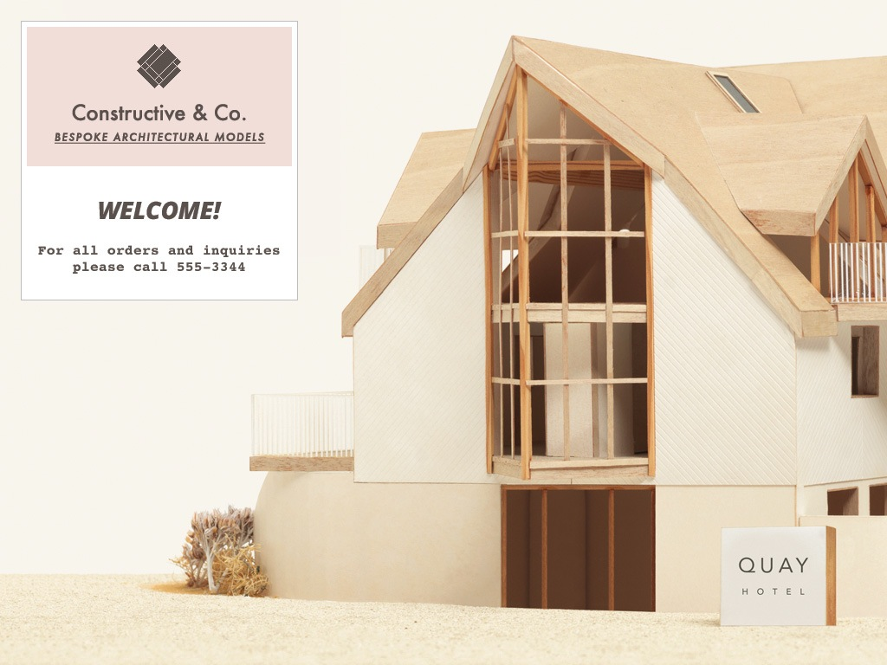

Slide 40


